Slide 1
A fishing trip to Data Lake
Brian Mapes, reporting the work of Leif Denby
GES-DISC UWG telecon, March 20, 2020

Slide 2
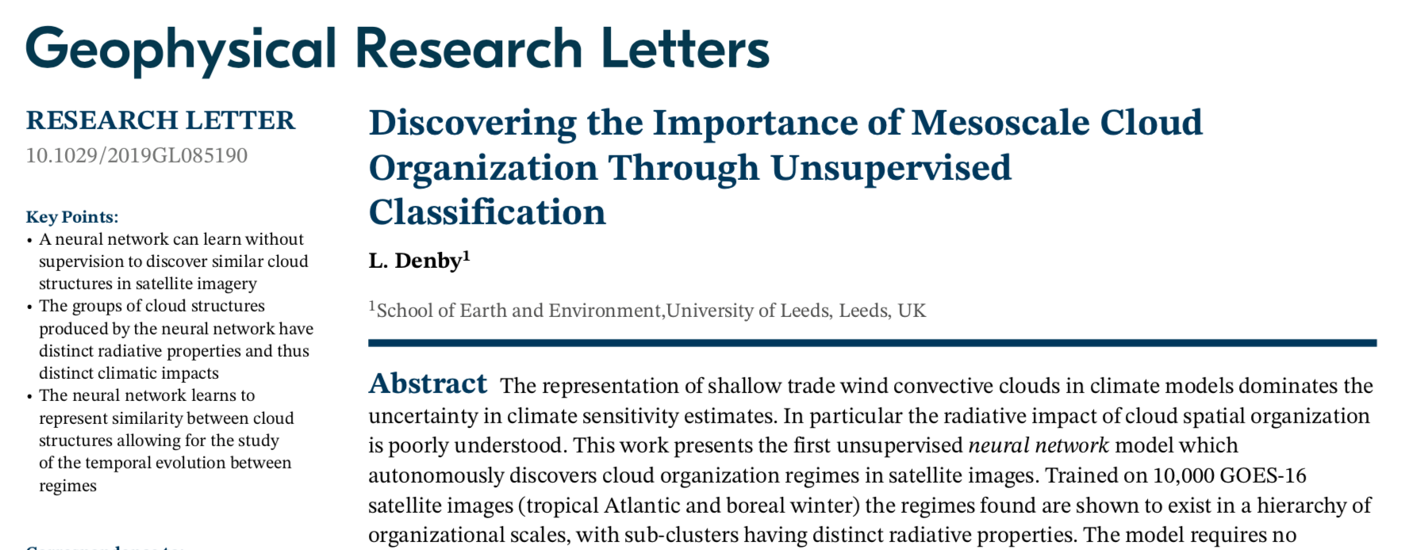
Leif’s 2020 GRL, & visit to my graduate data class
10.1029/2019GL085190

Slide 3
The heart of it: Triplet Trainer tt
“Machine learning” is always an optimization
e.g. summed squared error (min) → least-squares
a ”classical” example of “supervised” learning
when input data have a y value for each x value
in other words, “labeled” data

Slide 4
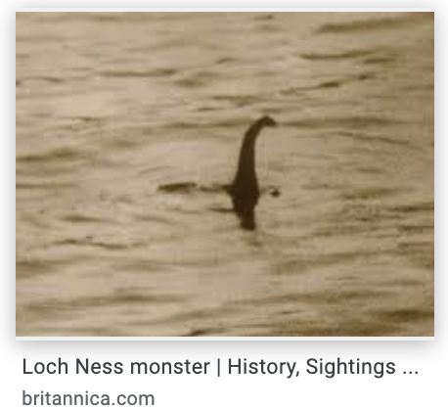
The heart of it: Triplet Trainer tt
How about “unsupervised” ML classification?
The conceptual essence:
These are similar, those are different
Data Lake is where the Different live…

Slide 5
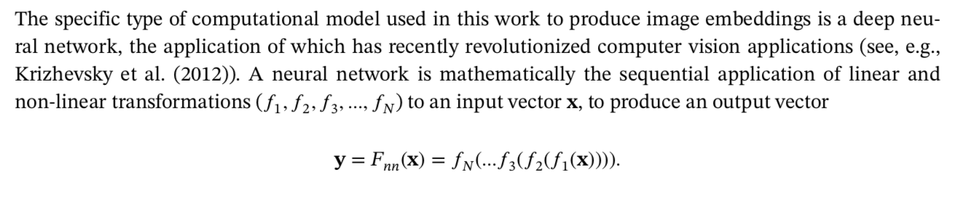
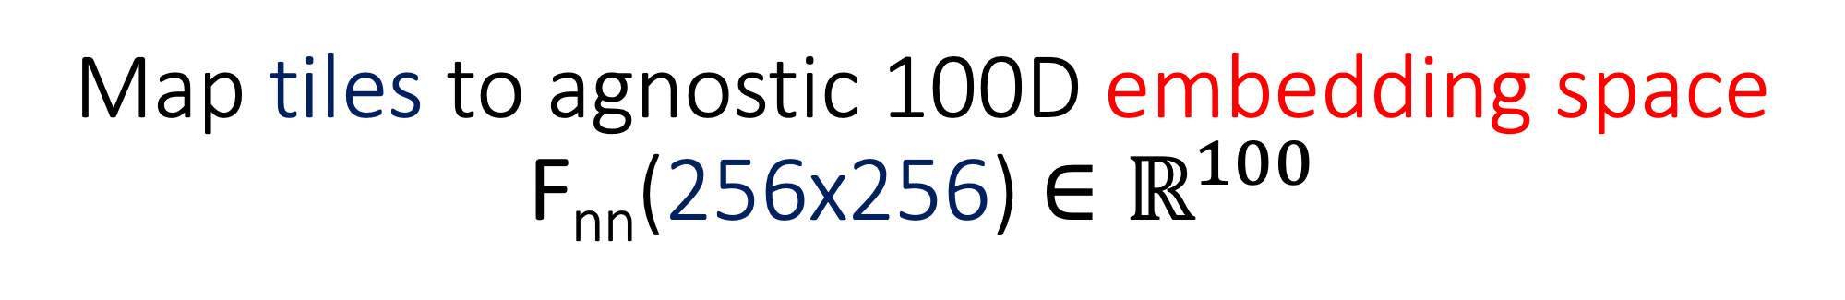
Map tiles to agnostic 100D embedding space F_{nn}(256x256) $∈ℝ^{100}$

Slide 6
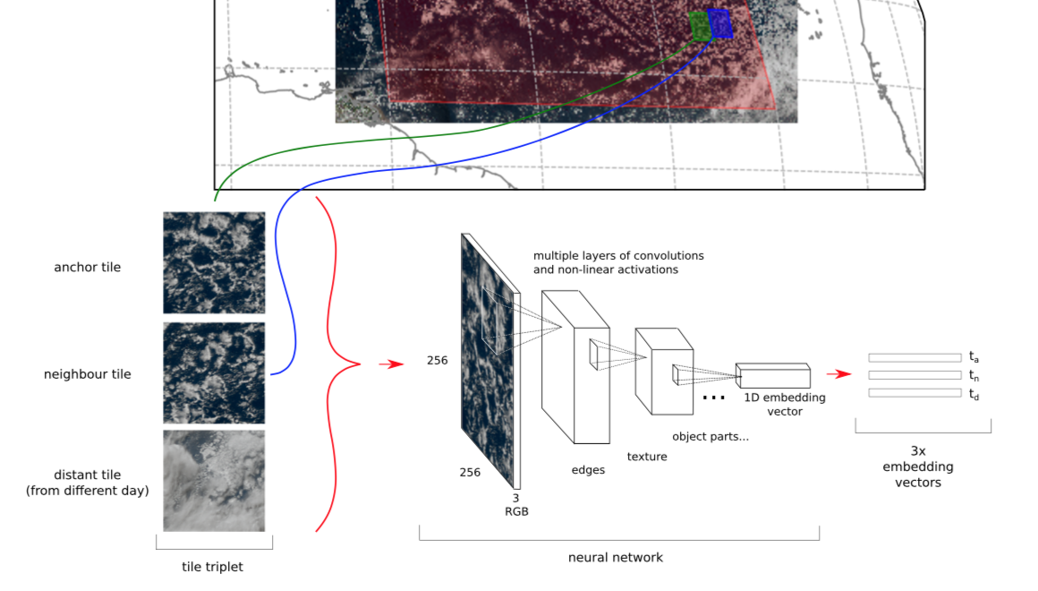
Map tiles to agnostic 100D embedding space F_{nn}(256x256) $∈ℝ^{100}$
Partly overlapping;
rotated & flipped to prevent overfitting of simple anisotropies
Ideally, a TOTALLY → different day (like another year). Bigger lake is better!

Slide 7
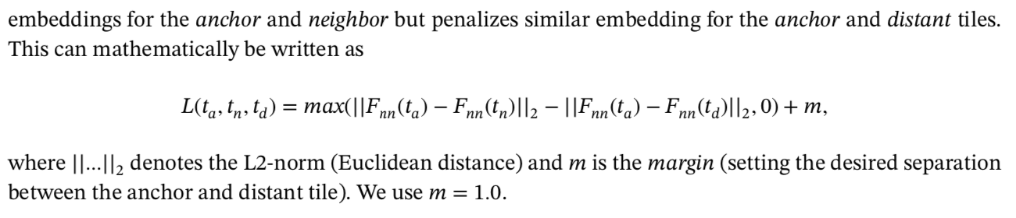
Map tiles to agnostic 100D embedding space F_{nn}(256x256) $∈ℝ^{100}$
NN optimizes a function which encourages similar (nearby in embedding space)
(yes, there is a typo -- +m belongs inside the parentheses!)

Slide 8
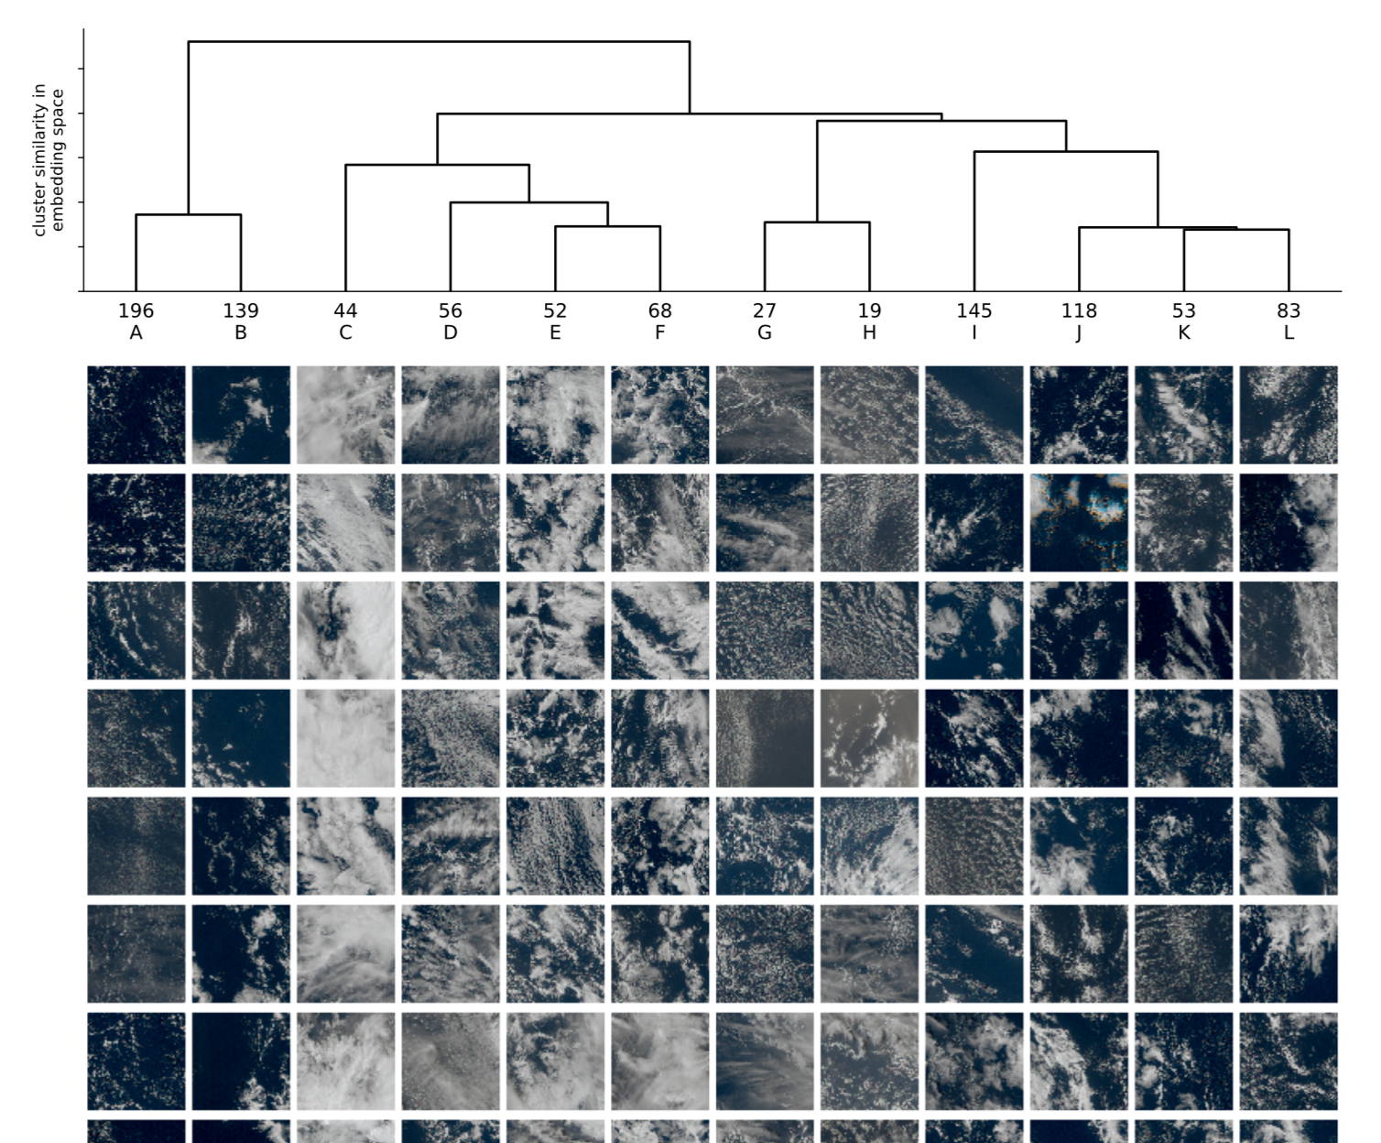
Further work reduces the 100D space to any desired number of discrete categories
hierarchical clustering of an out-of-training-sample study set into types A-L →

Slide 9
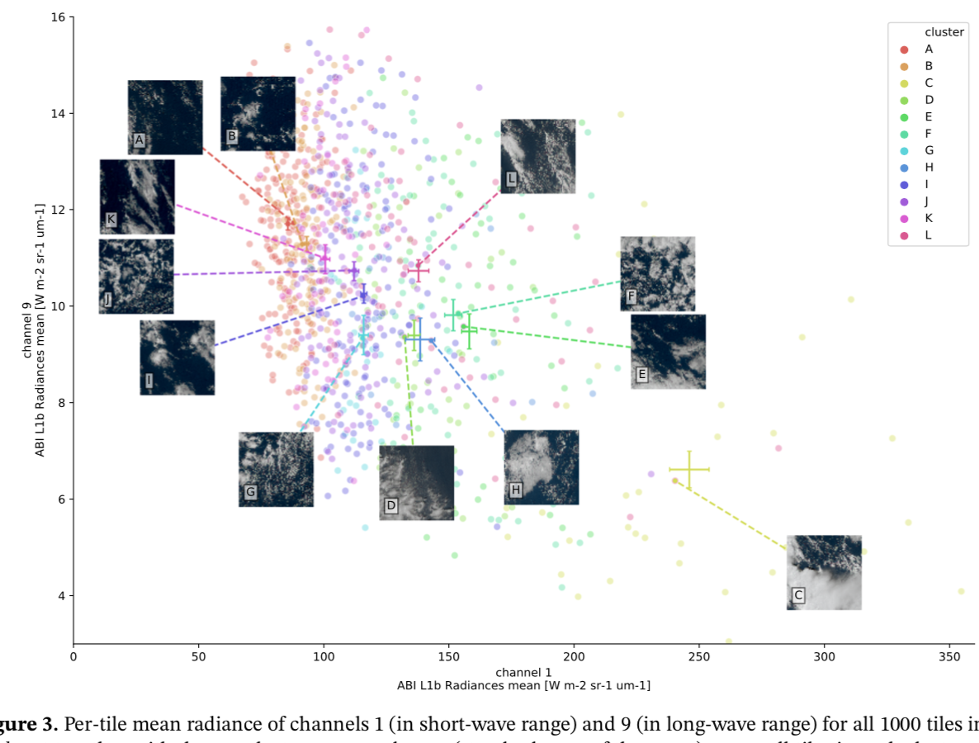
Categories are distinct in climatic FUNCTION (radiative impact), not just in trained FORM (texture)

Slide 10
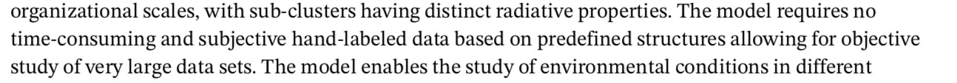
→ Taxonomy by (computer-)visual resemblance including texture information lost in usual “pixel pooling”
Now human interpretation can be brought in: at the level of categories, not at the level of instances (hand-labeling of individual cases). Or as the paper says,

Slide 11

Data particulars
Image tile sampler in AWS cloud for similar & dissimilar tiles

Slide 12
10,000 tiles to train, 1000 to test
Training set ~ 20GB
downloaded to supercomputer with a GPU, optimized for matrix algebra
Training runs in about half an hour on one GPU
“The particular type of CNN used in this work is a so-called residual network, ResNet-34 (implemented in the pytorch framework, Paszke et al., 2017).”
“In a CNN, successive layers build increasingly higher abstractions (edges, arcs, composite shapes, etc.) from compositing spatially localized gradient calculations over multiple layers. “
Applying trained NN to independent inputs is instantaneous

Slide 13
Summary
Exploratory data analysis: classification based on similarity with neighbor, by contrast with distant sample
Cloud data lake is convenient for accessing samples of ”different”
General point: placing focus data in context of whole dataset adds value
c.f. my repeated wish that a MERRA-2 climatology were available on GDS
Main repo https://github.com/leifdenby/convml_tt
Exercises for my graduate class https://github.com/leifdenby/MPO624_convml_tt

